Slide 1

Diagnosing the Weakest Link in WSN Testbeds: A Reliability and Cost Analysis of the USB Backchannel
Pablo Guerrero, Iliya Gurov, Kristof Van Laerhoven, Alejandro Buchmann

Slide 2
Testbeds 101
Debugging and reprogramming used often in experimentation
Testbed’s goal: to facilitate WSN experimentation through
  centralized node reprogramming, and
  data collection for posterior evaluation.
Expensive scientific instrument:
  initial acquisition and deployment
  maintenance and operation
a) (remote) users
b) server
this work’s topic:
“backchannel”
c) sensor network

Slide 3
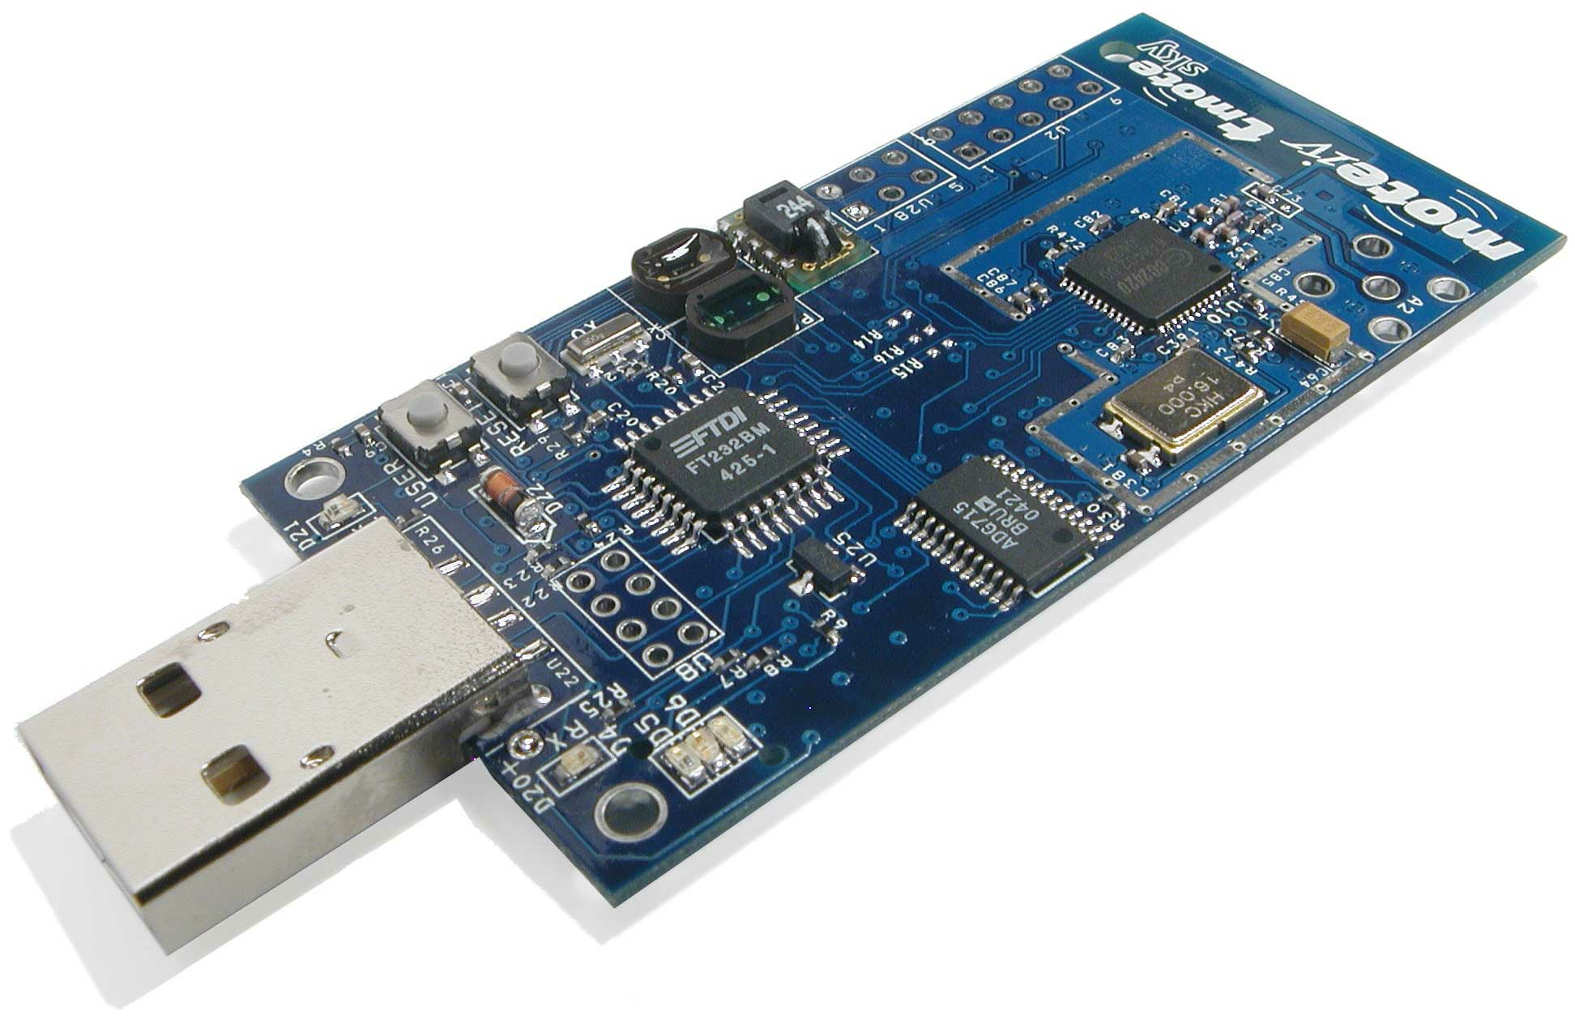
USB as Wired Interface to Sensor Nodes
USB (probably) first introduced with Telos design
  USB-to-serial chip to access MCU
  node powered via USB port, if connected

Slide 4
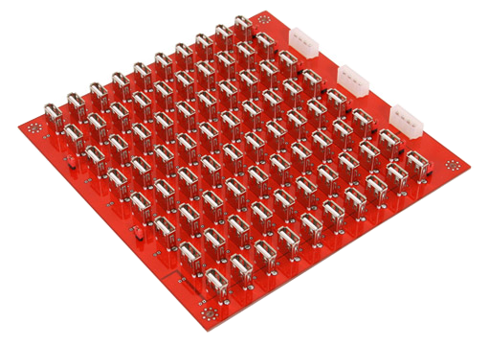
Wired, USB Backchannel
without support layer
- 1:48 [SignetLab]
server
USB
sensor network

Slide 5
Wired, USB Backchannel
with support layer
server
Ethernet
support layer
USB
sensor network

Slide 6
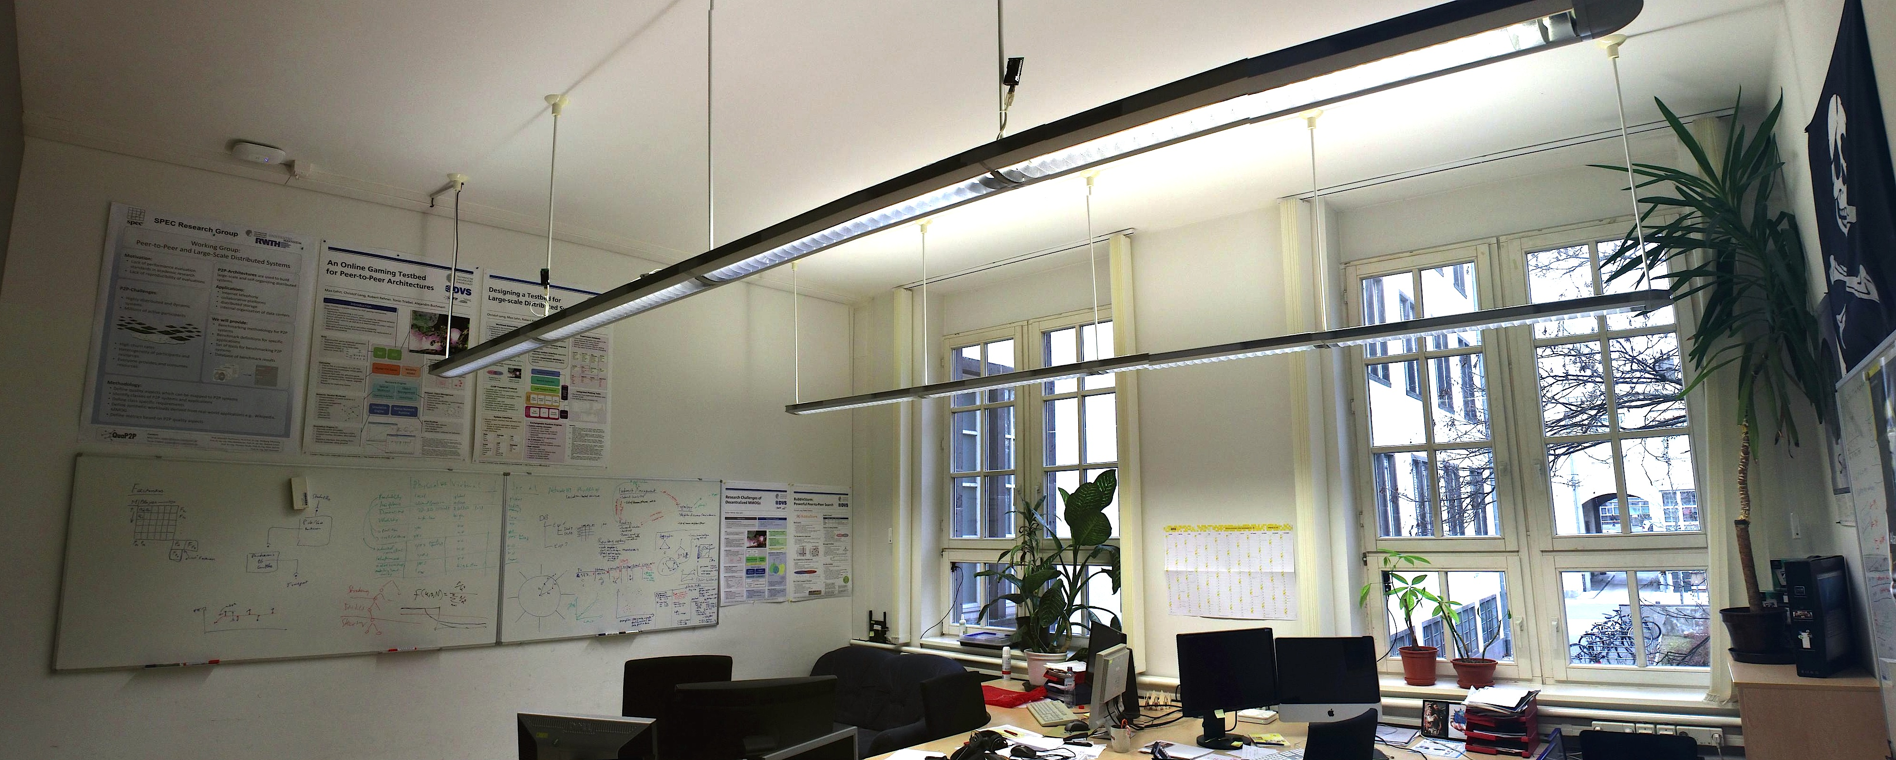
Wired, USB Backchannel
with support layer
server
- 1:{2..6} [TUDμNet, TWIST]
- 1:22 [Indriya]
Ethernet
support layer
USB
sensor network

Slide 7
Challenges
Permanent, distributed sensor network testbeds require unattended operation. But:
Bug(s) in USB implementation, USB hardware, bootstrap loader, power variations, etc. → hard to reproduce!
Goals: high reproducibility, comparability, and availability of nodes

Slide 8
Systematic Evaluation
Methodology:
  set up backchannel [node(s), cable(s), hub(s)]
  test power and enumeration
  run micro-benchmark
    repetitively reprogramming a node (until failure / 1000 times)
Metrics:
  reprogramming time, [seconds]
  reprogramming cycles between failures, RCBF, [cycles]

Slide 9
USB Backchannel Topologies
A Universal Serial Bus is a layered
star topology:
  hubs at each star’s center
  127 devices max.
  7 layers max.
Cables
  passive: up to 5m long
  active: up to 12m long
Hubs
  passive (bus-powered)
  active (self-powered)

Slide 10
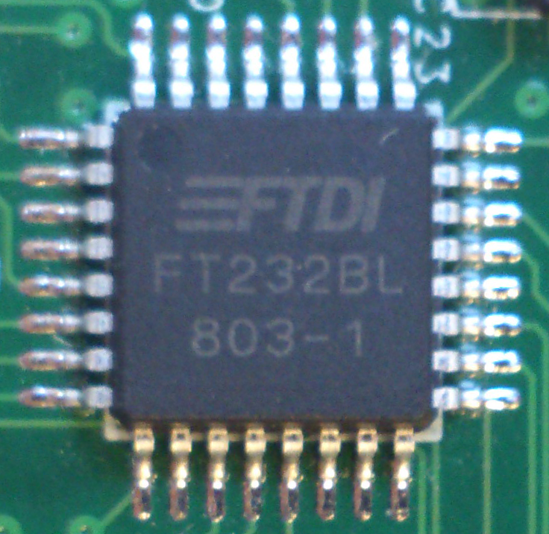
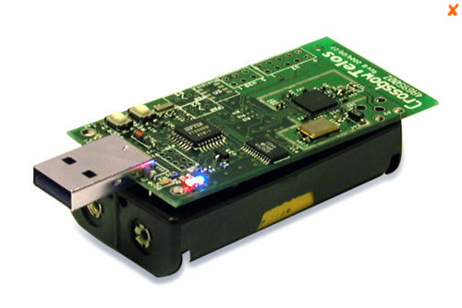
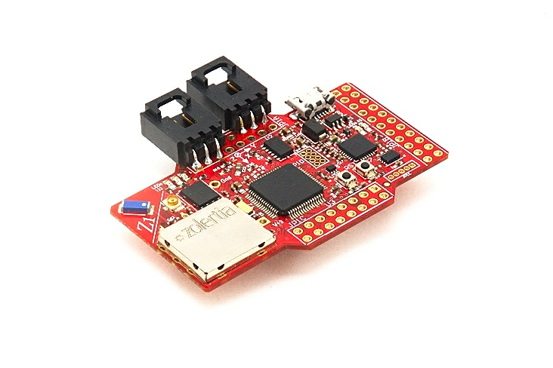
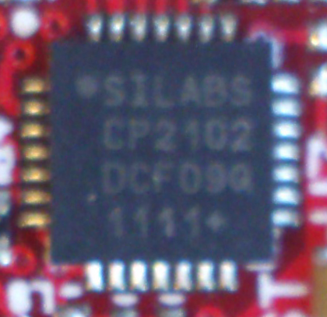
Node Evaluation:
Test Files and Reprogramming Time
FTDI chip
SiLabs chip

Slide 11
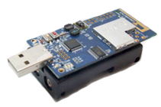
Node Evaluation:
Manufacturers
FTDI
chip
SiLabs
chip
reliability independent of manufacturer and USB chip

Slide 12
Topology Evaluation:
Single Node Tests, Passive Cables
Reprogramming Time per Cycle (secs)
Reprogramming Cycles Between Failures
Total USB Cable Length (m)
passive cables: up to 10 meters

Slide 13
Topology Evaluation:
Single Node Tests, Active Cables
Reprogramming Time per Cycle (secs)
Reprogramming Cycles Between Failures
Total USB Cable Length (m)
active cables: < 40 m (unreliable) or < 10m (reliable)

Slide 14
Topology Evaluation:
Single Node Tests, Active Hubs + Passive Cables
Reprogramming Time per Cycle (secs)
Reprogramming Cycles Between Failures
Total USB Cable Length (m)
active hubs and passive cables: 54m (unreliable) or 43m (reliable)

Slide 15
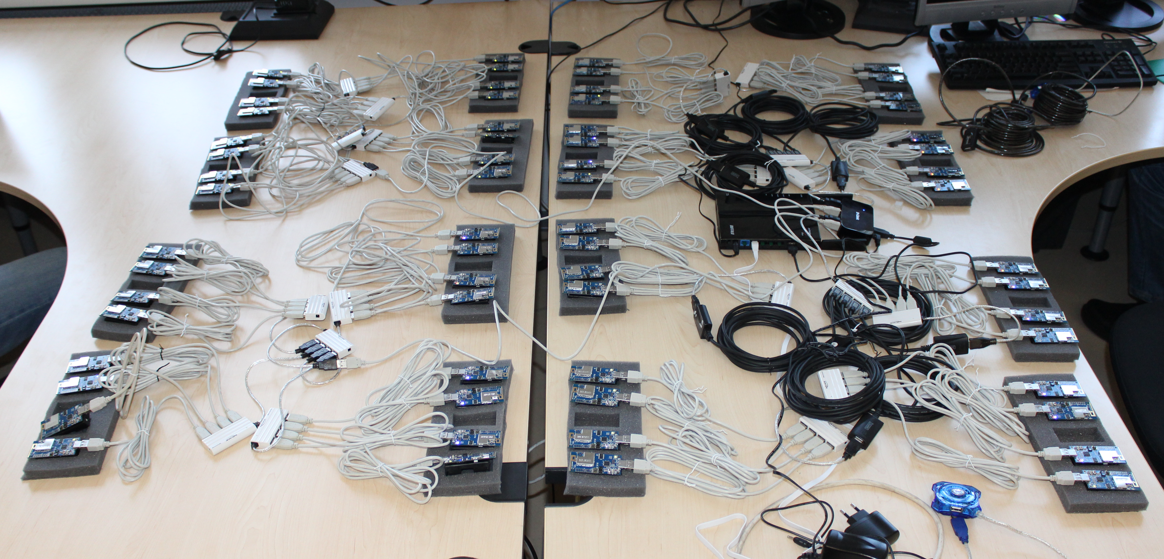
Topology Evaluation:
Multi Node Tests, Topologies
6x6
3x3
3x5
7x7
6x4
8x8
stable topologies: balanced trees

Slide 16
Topology Evaluation:
Multi Node Tests, Microbenchmark
Extensions:
  maximum parallelism
  node grouping
1st
2nd
3rd
4th
time
N1
N2
N3
N4
1st
2nd
3rd
time
N1
N2
N3
N4
N5
N6
N7
N8

Slide 17
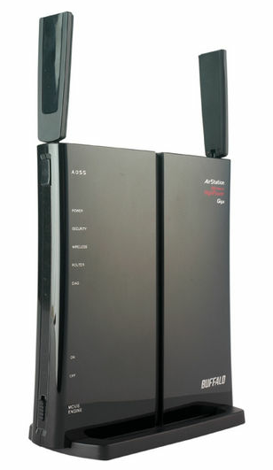

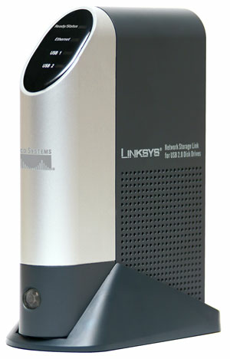
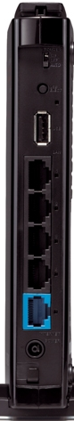
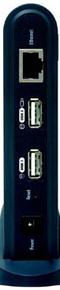
Multi Node Tests:
Gateway Selection & Parallelism
 | slug | buffalo | pc
max ||° | 5 | 8 | 59
real: 36% faster
more nodes → faster gateway needed (*)
parallelism can and should be exploited

Slide 18
Multi Node Tests:
Gateway Selection & Parallelism (2)

Slide 19
Enhancing Backchannel Reliability
Manual node reconnection costly
Solution: resort to hub port power control
  per port power switching
  ganged power switching

Slide 20
Enhancing Backchannel Reliability:
Quantification
choose HPPC-enabled hubs

Slide 21
Conclusions
USB is method of choice for testbed’s backchannels
Standard’s cabling restrictions can be overcome
Stable multi-node topologies can be built
HPPC-enabled USB hubs improve reliability

